Slide 1
Texas Tech University Health Sciences Center
Purchasing quarterly meeting
Ttuhsc pURCHASING

Slide 2
Agenda
General TechBuy information:
Types of orders that process in TechBuy
Non-Catalog
Hosted Catalog
Punch-out
Direct Pay
Shopping carts
How to remove extra order from cart
Airgas punch-out changes
Email approval code
RFP Requirement Changes
Additional documentation will be required – More to come……
Contracting Templates
Purchasing Email
Sciquest.com emails
Correct email: purchasing@ttuhsc.edu
Travel
Documentation
Accounts Payable
Receiving
Attaching invoices in TechBuy
PCard
Logging in issues
Questions and Answer Period

Slide 3
There are 4 types of orders that process in TechBuy:
Non-Catalog Purchase Order
Hosted Catalog Purchase Order
Punch-out Purchase Order
Direct Pay

Slide 4
Non-Catalog
The non-catalog form is located on the home/shop page under forms.
The non-catalog form is used when requesting a specific item or service that is not available through a punch-out or hosted catalog. Non-Catalog orders require a quote to be attached in the external notes. The quote and the purchase order should match. If all items are not being ordered please make a note in the internal notes.

Slide 5
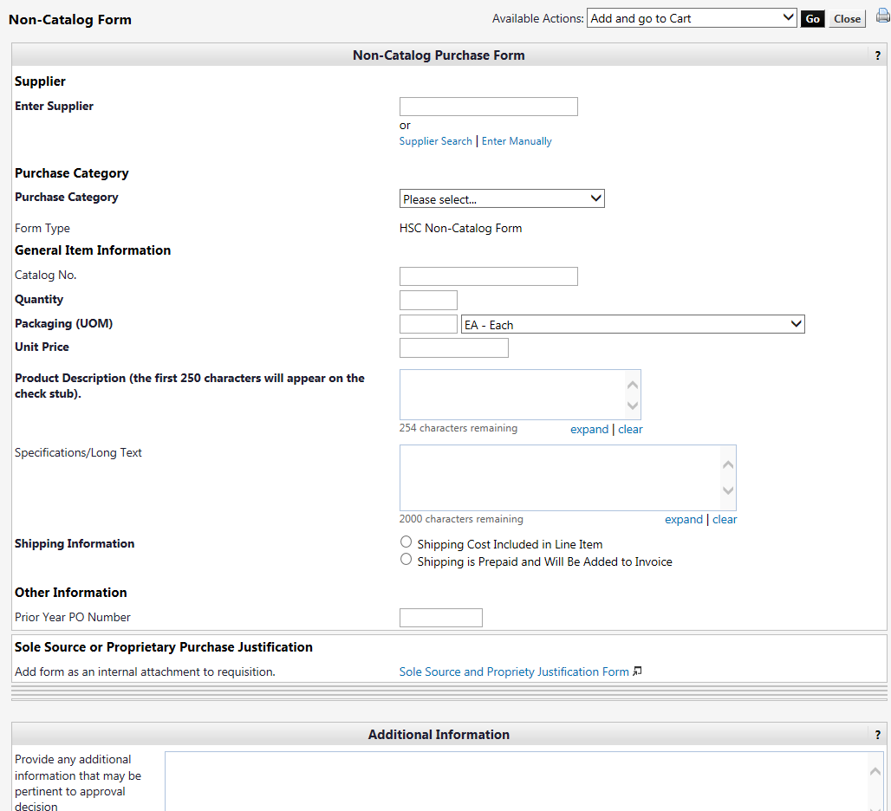

Slide 6
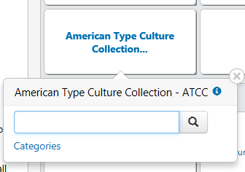
Hosted Catalog
The hosted catalog vendors are located on the home/shop page.
The hosted catalog is an online version of a supplier’s printed catalog. Hosted catalogs contain product data and details, along with pricing information for each item.

Slide 7
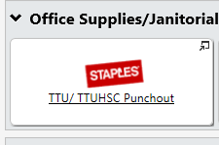
Punch-Out
Punch-out vendors are located on the home/shop page. Punch-out orders are integrated external links to a supplier’s web-based catalog. The user exits the TechBuy site to search and select products from a supplier’s web catalog, then returns the items to the TechBuy shopping cart.

Slide 8
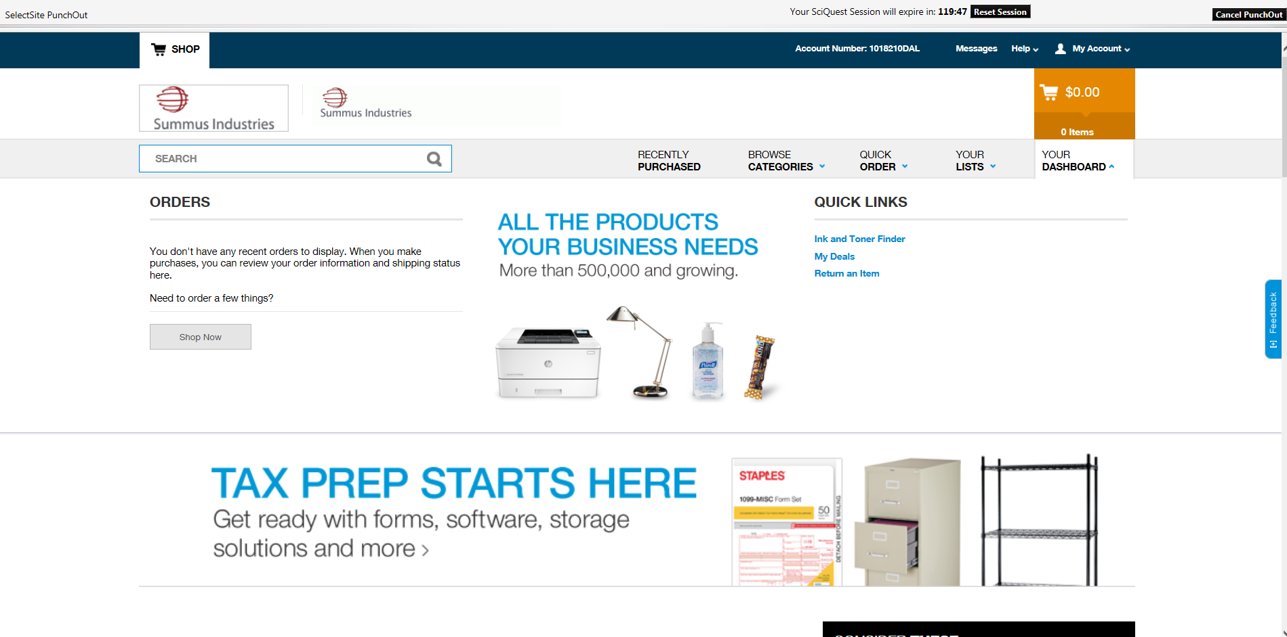
The vendors punch-out sticker will take you out to the vendors website for shopping.

Slide 9
Direct Pay
There are 15 different Direct Pay forms located on the home/shop page. Each form was created to process a specific type of request/payment.

Slide 10
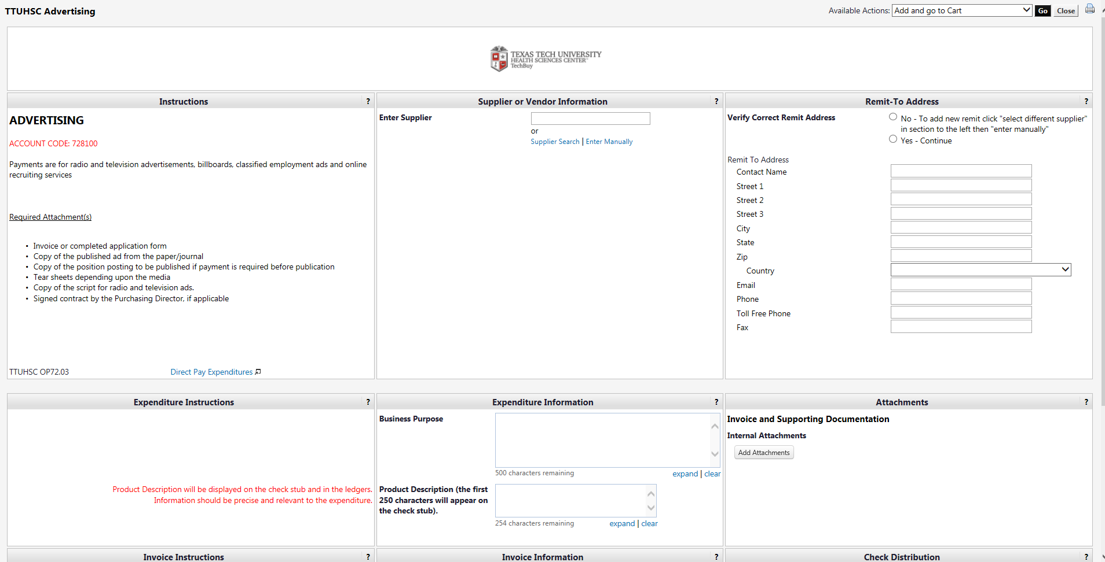
Each Direct Pay form is titled and has instructions listed on the left side column.

Slide 11
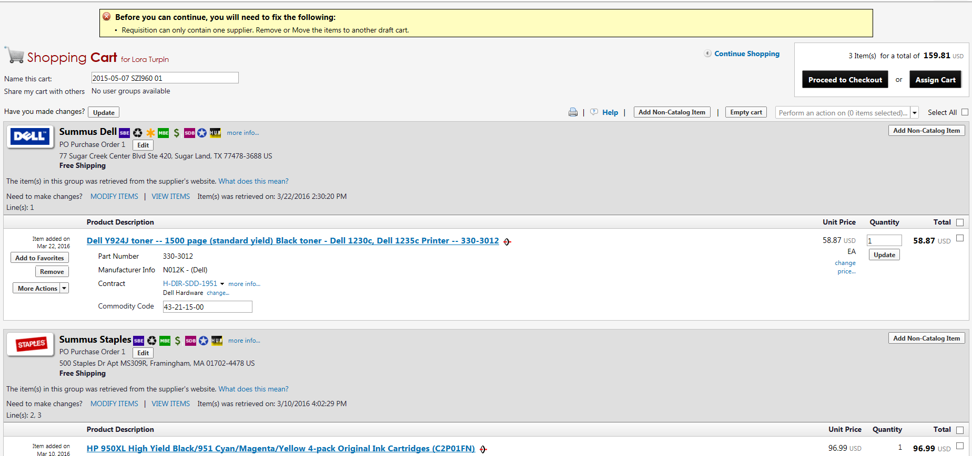
Shopping Carts
Only one vendor cart is allowed in a shopping cart. If more than one vendor is in the shopping cart you will receive the error below.

Slide 12
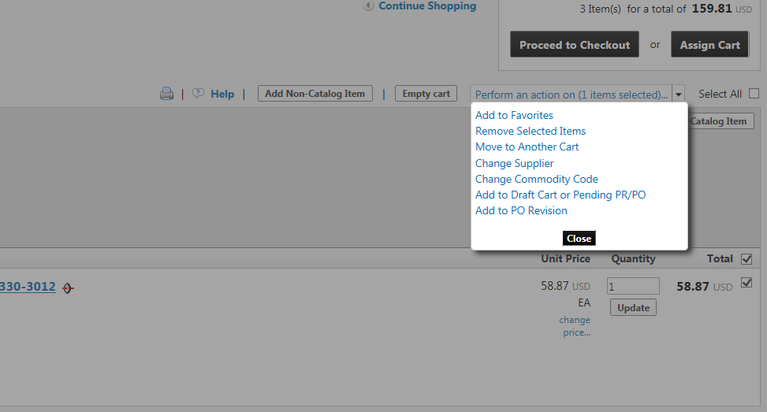
To move lines from a shopping cart, select the lines to be moved and select move to another cart in the perform an action drop down.

Slide 13
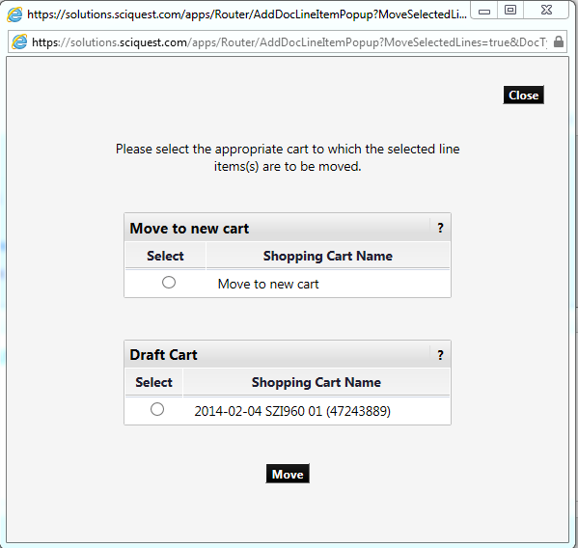
Select move to a new cart.
c

Slide 14
To retrieve the order you moved, go to your draft carts to submit the order you just moved to a new cart.

Slide 15
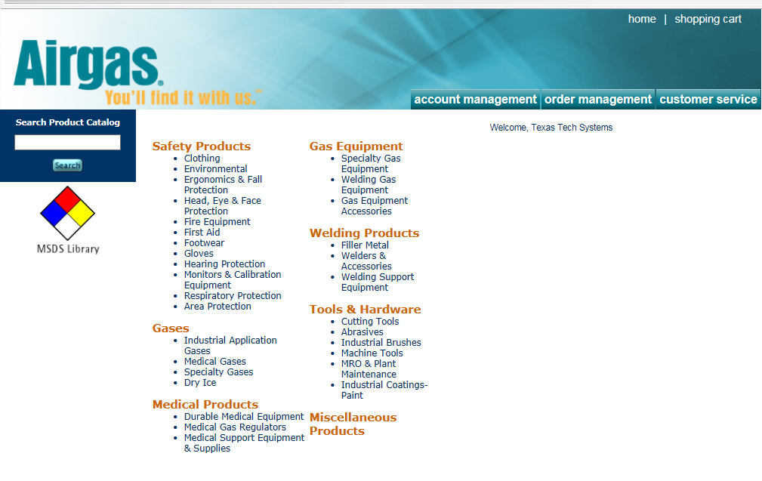
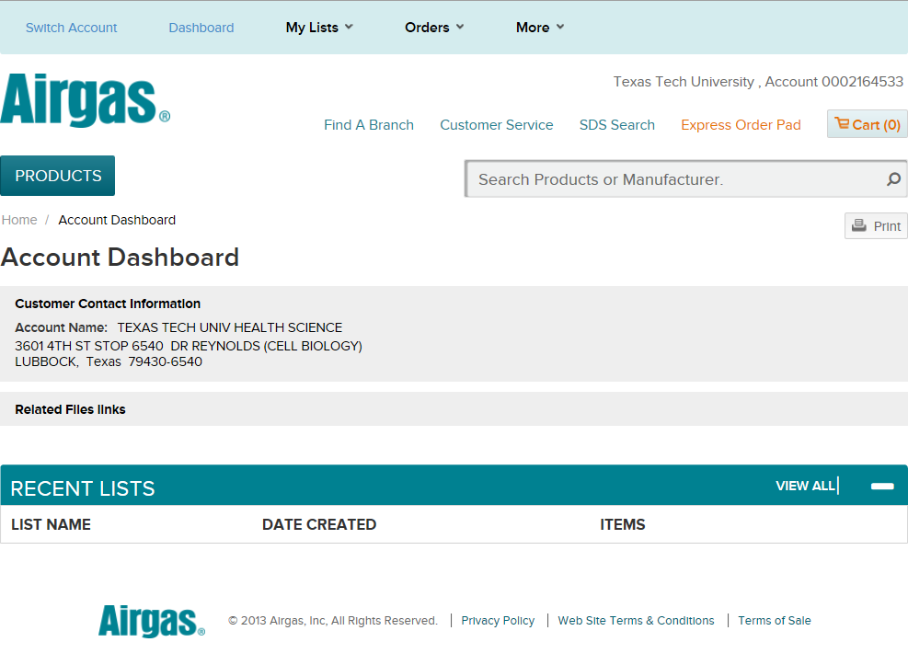
Airgas
Airgas is changing the look of their punch-out site. Their new site still has the same functionality and the same pricing.
Current Site
New Site

Slide 16
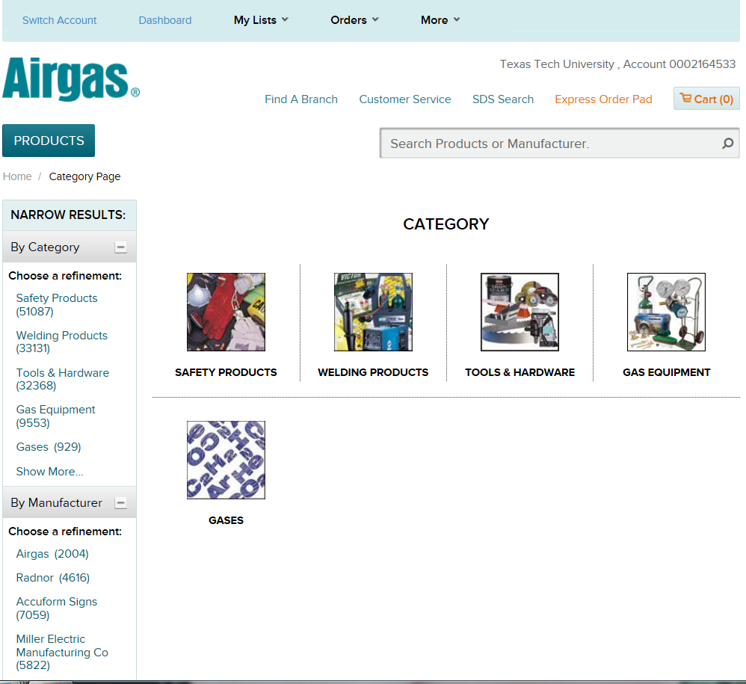
Click on Products to pull up categories.

Slide 17
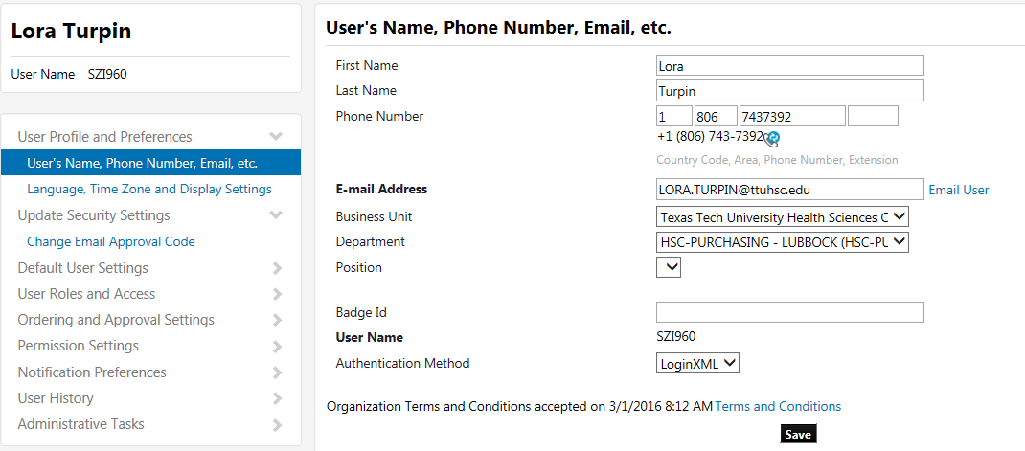
Email approval code
Fund managers that approve TechBuy orders by email will need to set up an email approval code in their profile.
Select Change Email Approval Code.

Slide 18
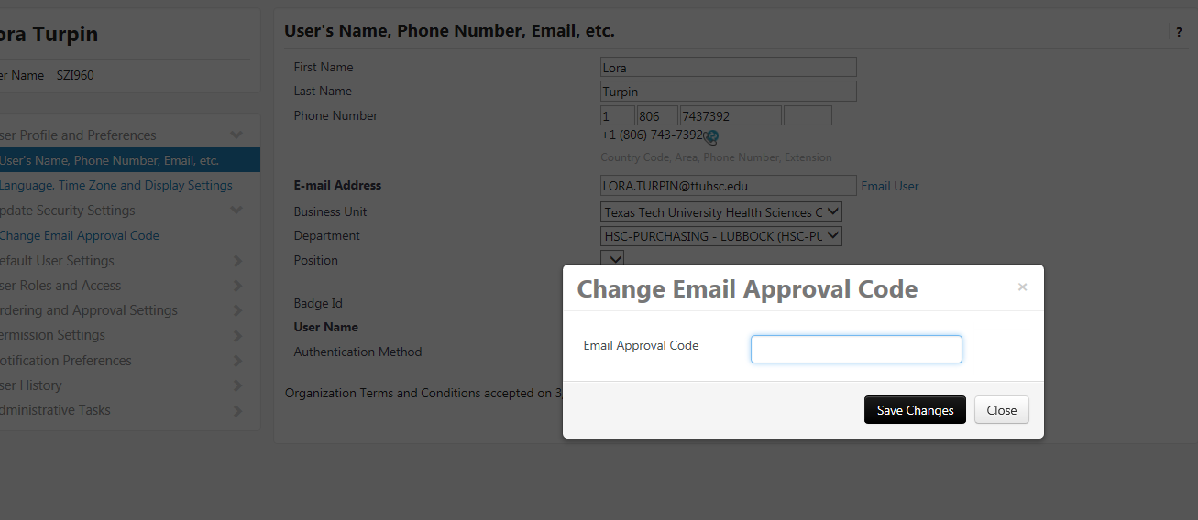
Enter the approval code you would like to use and click save changes.

Slide 19
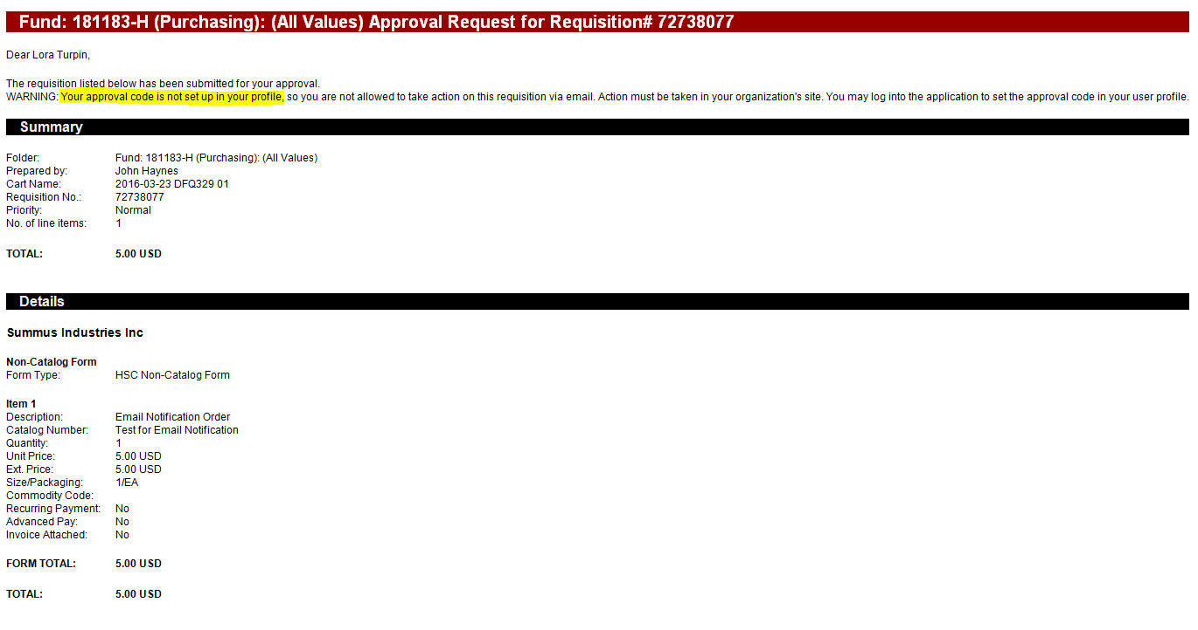
If an approval code is not set up, the email received will state a warning that an approval code will need to be set up to approve through email. Action cannot be taken through email until an approval code is set up. The fund manager will have to log into TechBuy to approve the order.

Slide 20
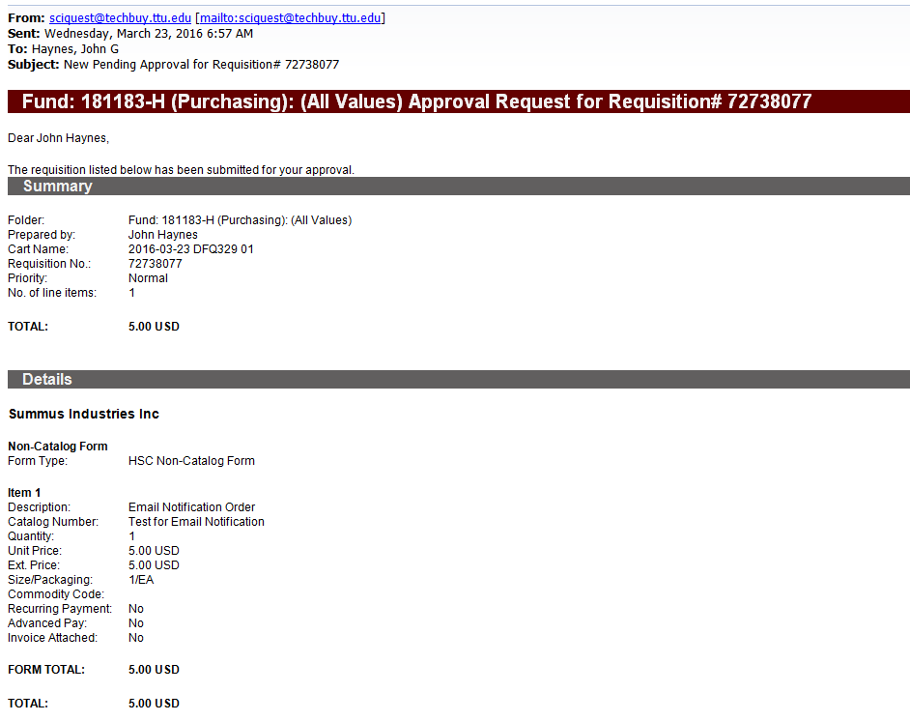
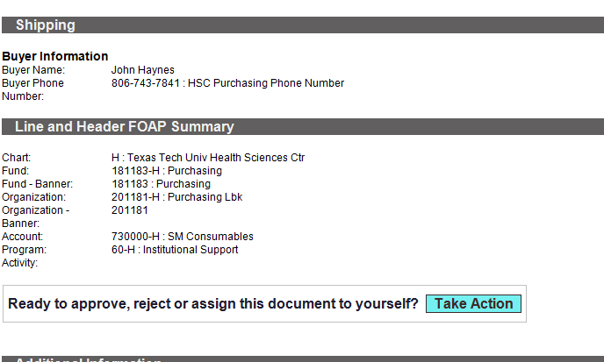
When an approval code is set up, the fund manager will receive an email requesting approval. When ready to approve click take action.

Slide 21
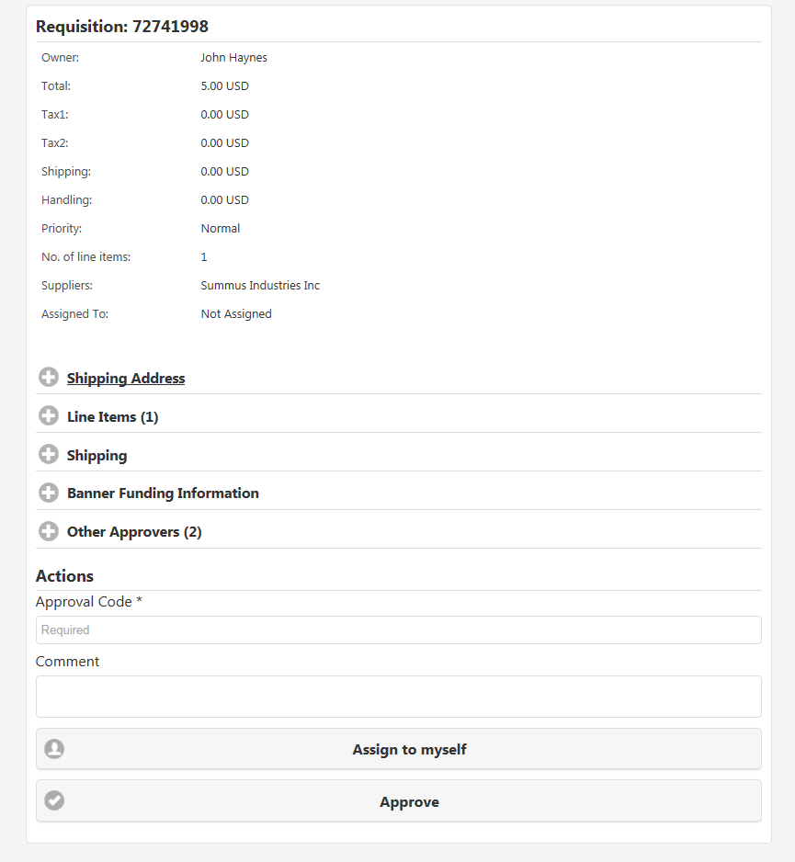
Take action will take you to the screen below. The system will require an approval code and click approve.

Slide 22
Changes to the Solictation/Expense Contract Process
Legislative action and the requirements contained in SB20 and HB1295 are resulting in changes to the solicitation, contracting and purchasing process across the TTU-System.
Highlights
Development and implementation of a Contracting Handbook
Implementation of solicitation request process.
Additional approval for some expense agreements. (BOR approval for agreements of $1 mil.)
Completion of risk analysis for solicitations and complex/high risk orders/contracts.
Completion of Conflict of Interest statements for anyone involved in the procurement process.
Ethics reporting requirements for vendors.
Additional ethics training for individuals involved in the procurement process.

Slide 23
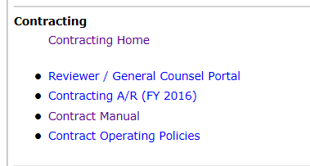
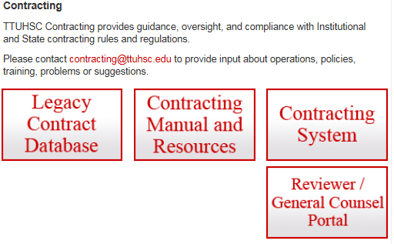
Contracting Templates
Contracting templates are available on the contracting site. From F&A Work Tools, select Contracting Home. On the Contracting home page, select Contracting Manual and Resources.

Slide 24
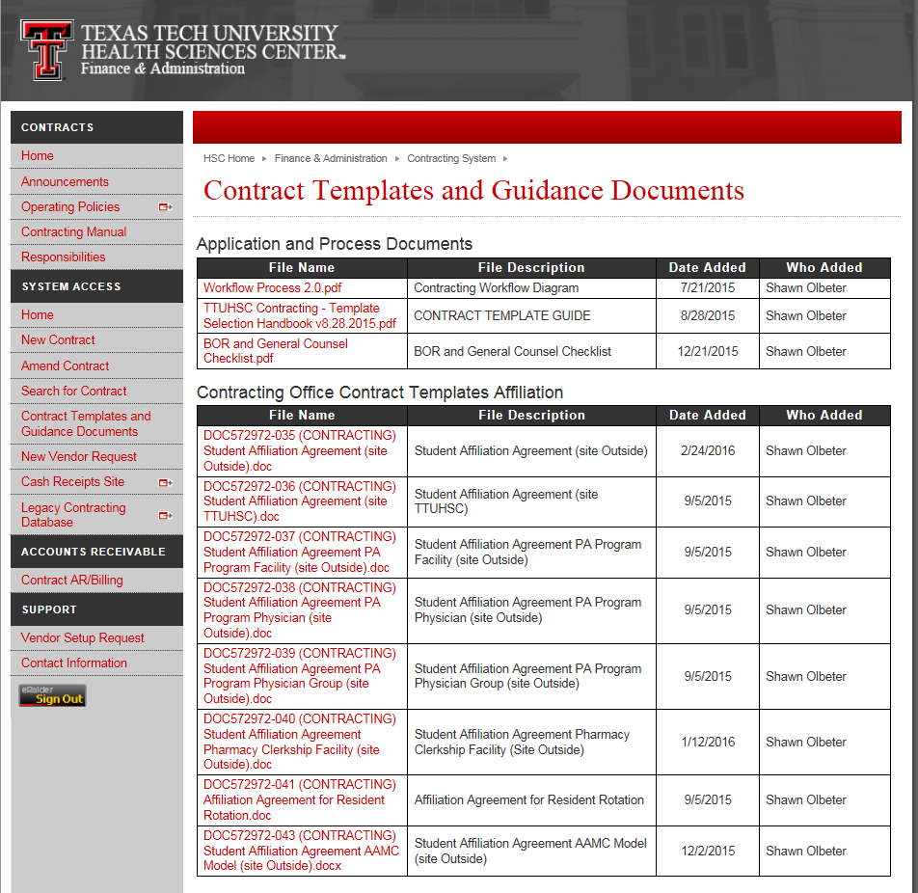
There are several templates available for review on the contracting site.

Slide 25
Purchasing Email
System Generated emails – DO NOT hit reply to system generated emails (emails that come from SciQuest). SciQuest emails are monitored by TTU staff and only one HSC staff member. Please create a new email or forward email to Purchasing@ttuhsc.edu
Please make sure to use the correct Purchasing inbox email address: Purchasing@ttuhsc.edu

Slide 26
Travel
If you upload all travel voucher documentation and sign electronically, do not send original documentation to the Travel Office. Keep all original documents for departmental records.
If travel is to attend a conference, a conference fact sheet or agenda with conference, location, date and times must be included in the travel voucher documentation.

Slide 27
Accounts Payable
Make sure that you complete receiving in TechBuy as soon as you receive ordered items.
If you attach a vendor invoice for an order in TechBuy, you must add a comment to the Purchase Order notifying us that a vendor invoice has been attached. Add Accounts.Payable@ttuhsc.edu as an email recipient before completing the comment. If you do not notify us about the attached invoice, we do not know that the invoice is ready to pay.

Slide 28
PCard
If you are experiencing difficulties with logging in to the Citi Global Management website, please use this link: https://www.globalmanagement.citidirect.com.

Slide 29
Questions ?

